Slide 1
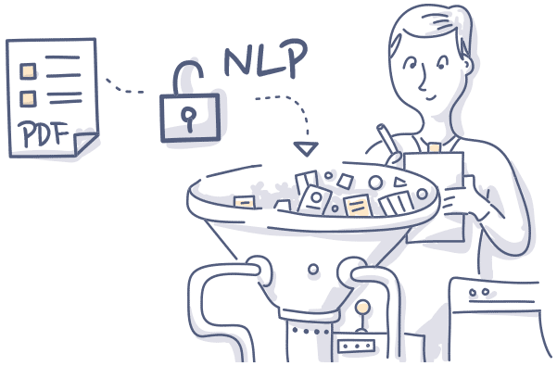
Adversarial attacks on
Natural Language Processing
Salijona Dyrmishi
salijona.dyrmishi@uni.lu
1
*Some slides are borrowed from various sources listed on the last slide

Slide 2
Adversarial attacks on
Natural Language Processing
Salijona Dyrmishi
salijona.dyrmishi@uni.lu
1
*Some slides are borrowed from various sources listed on the last slide

Slide 3
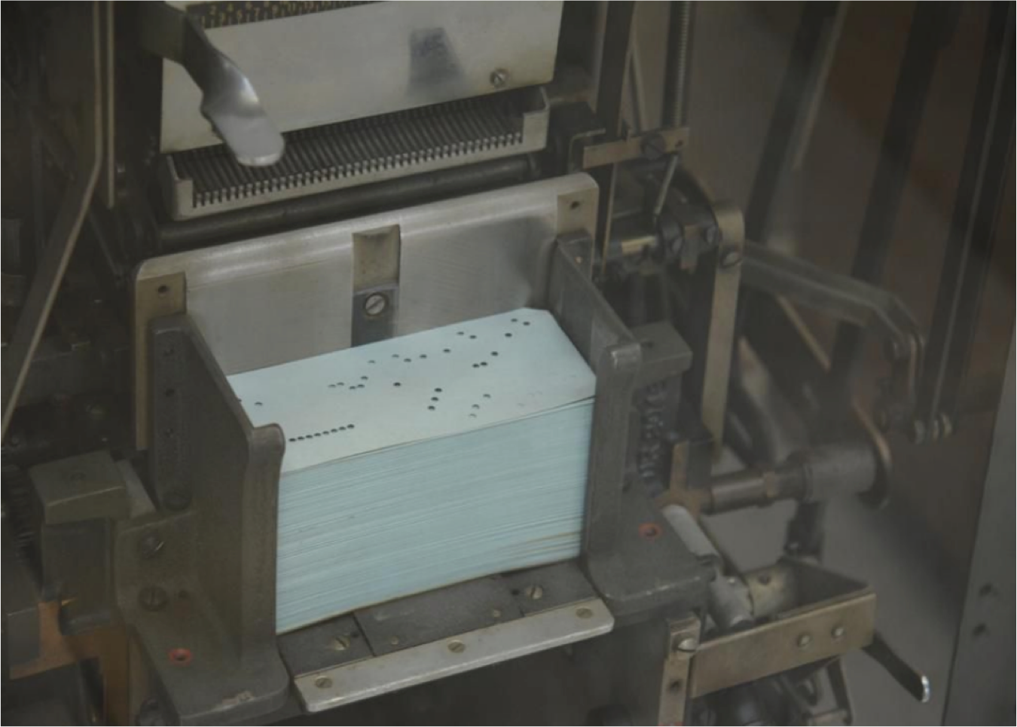
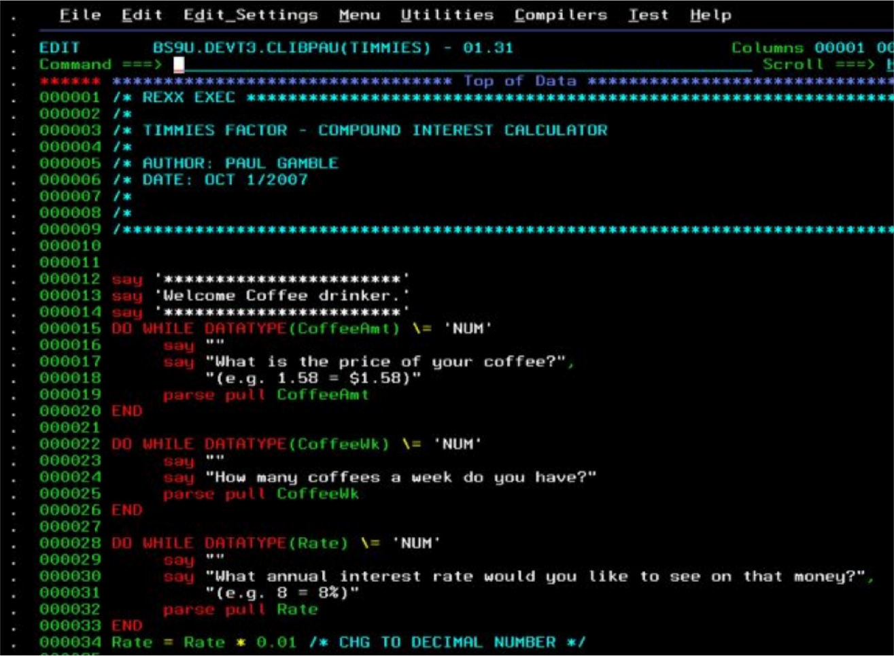
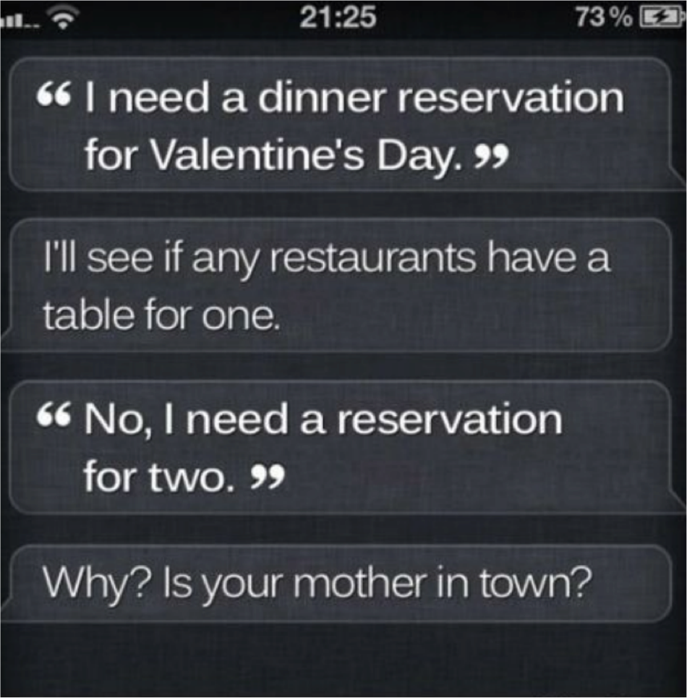
Communication With Machines
~50-70s
~80s
today
3

Slide 4
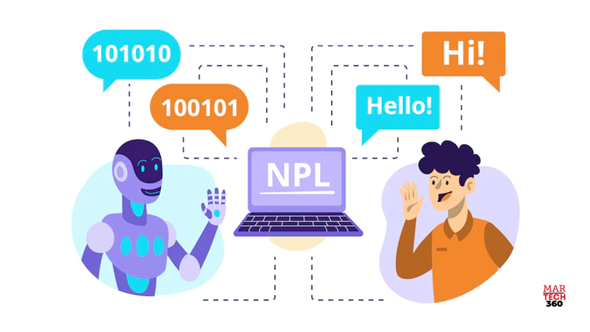
Natural Language Processing
NLP lies at the intersection of computational linguistics and machine learning.
4

Slide 5
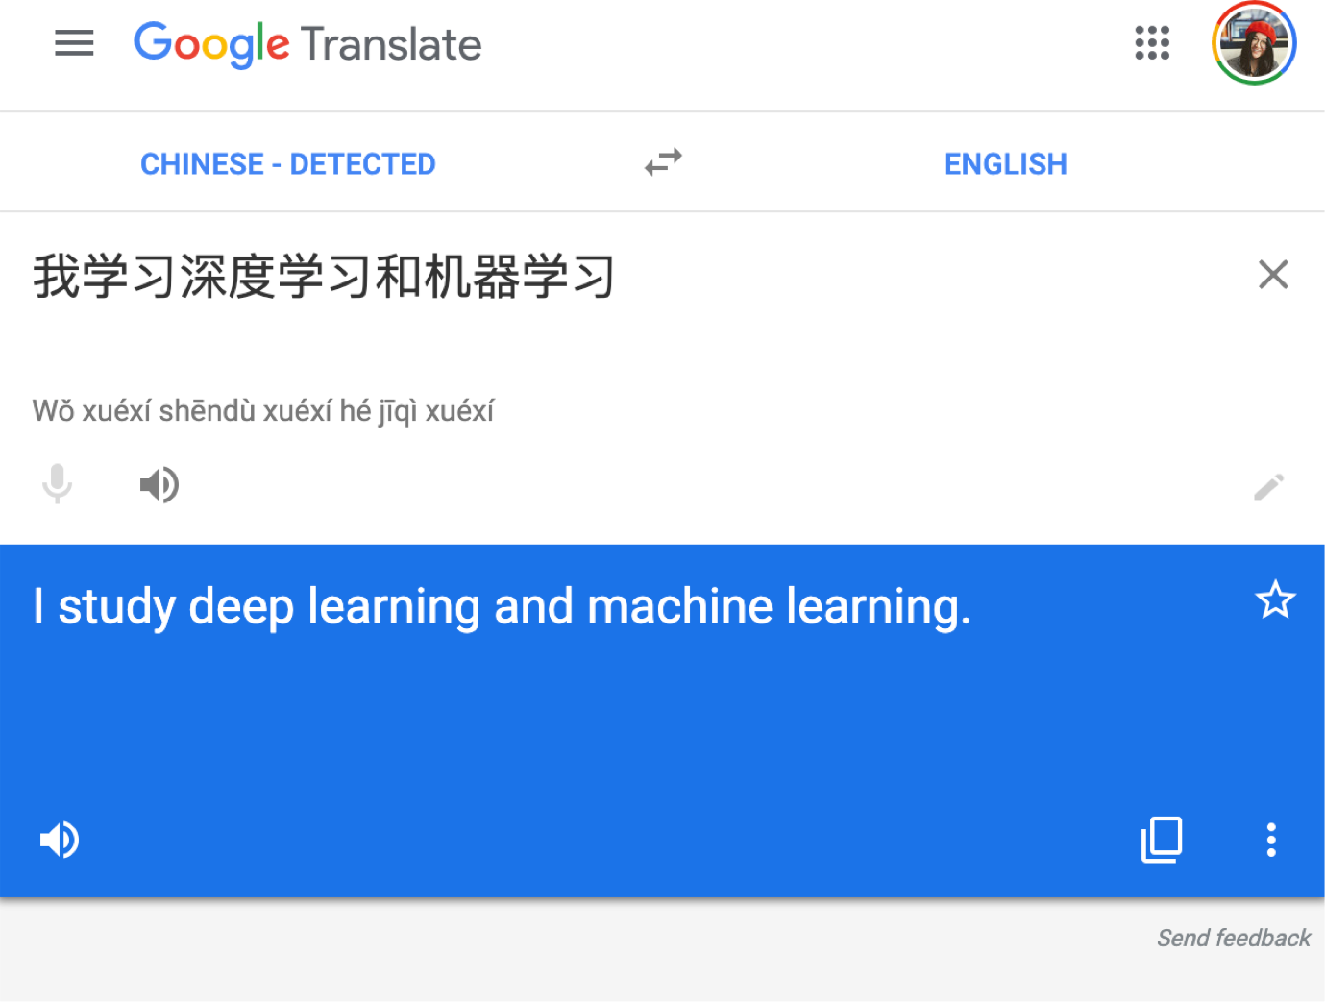
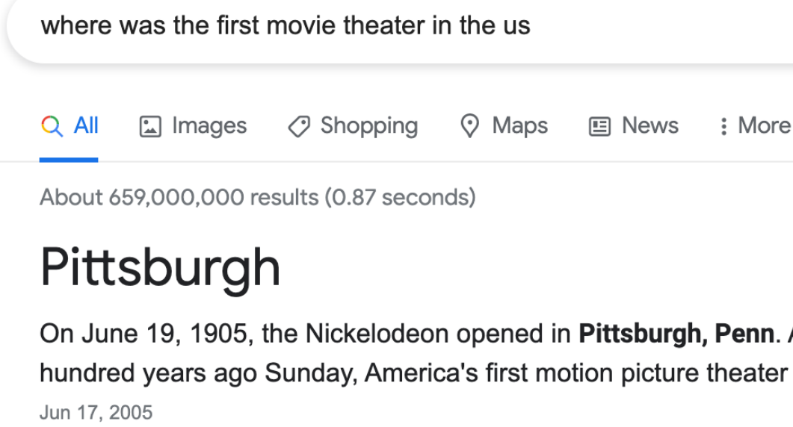
NLP applications
Machine Translation
Question Answering
9

Slide 6

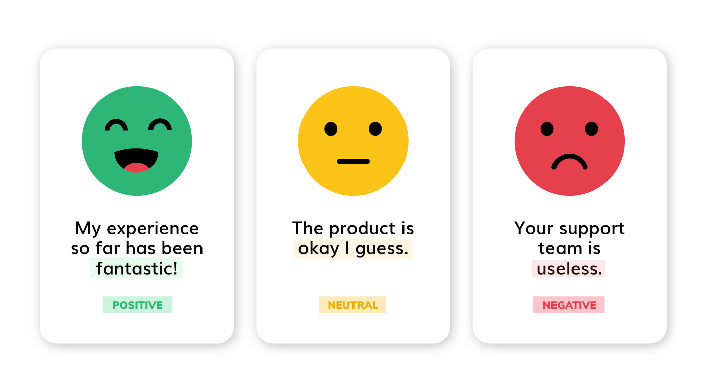
NLP applications
Paraphrasing
Sentiment analysis
9

Slide 7
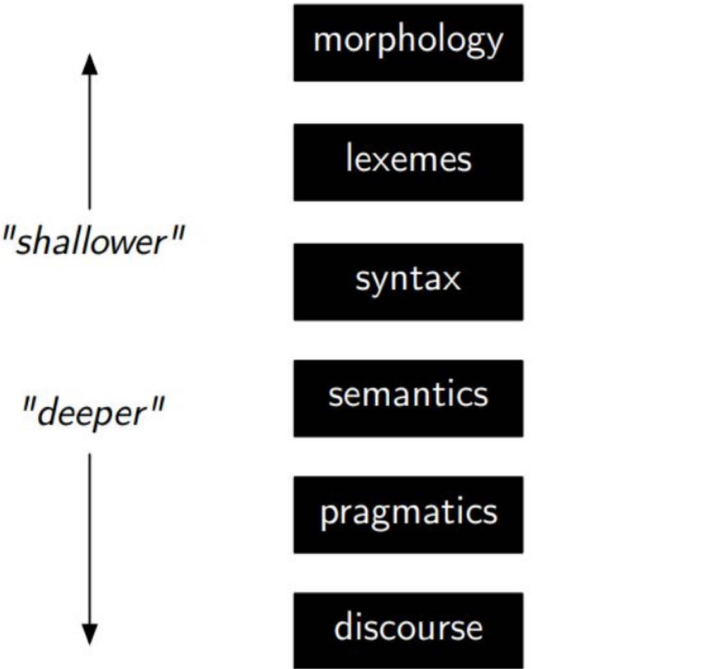
Level Of Linguistic Knowledge

Slide 8
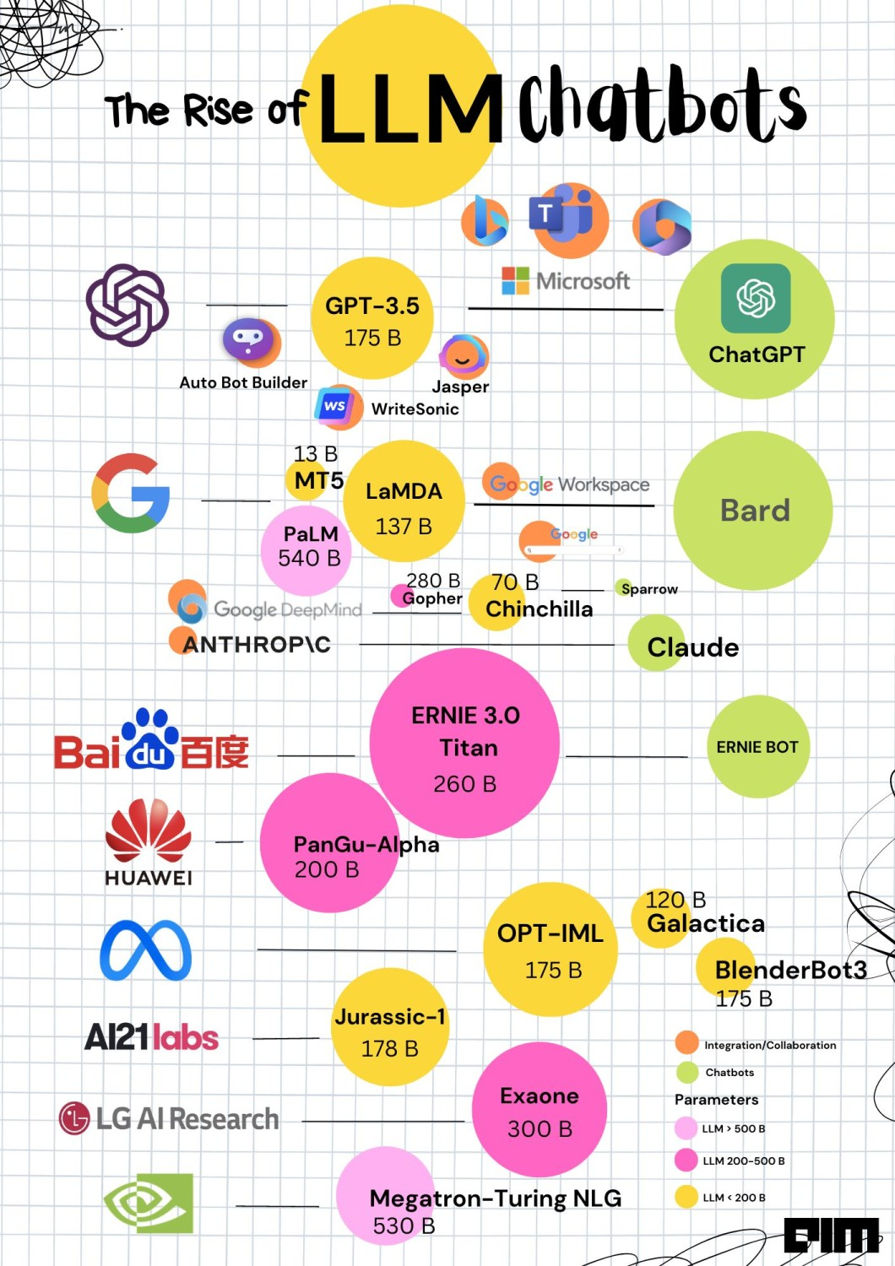
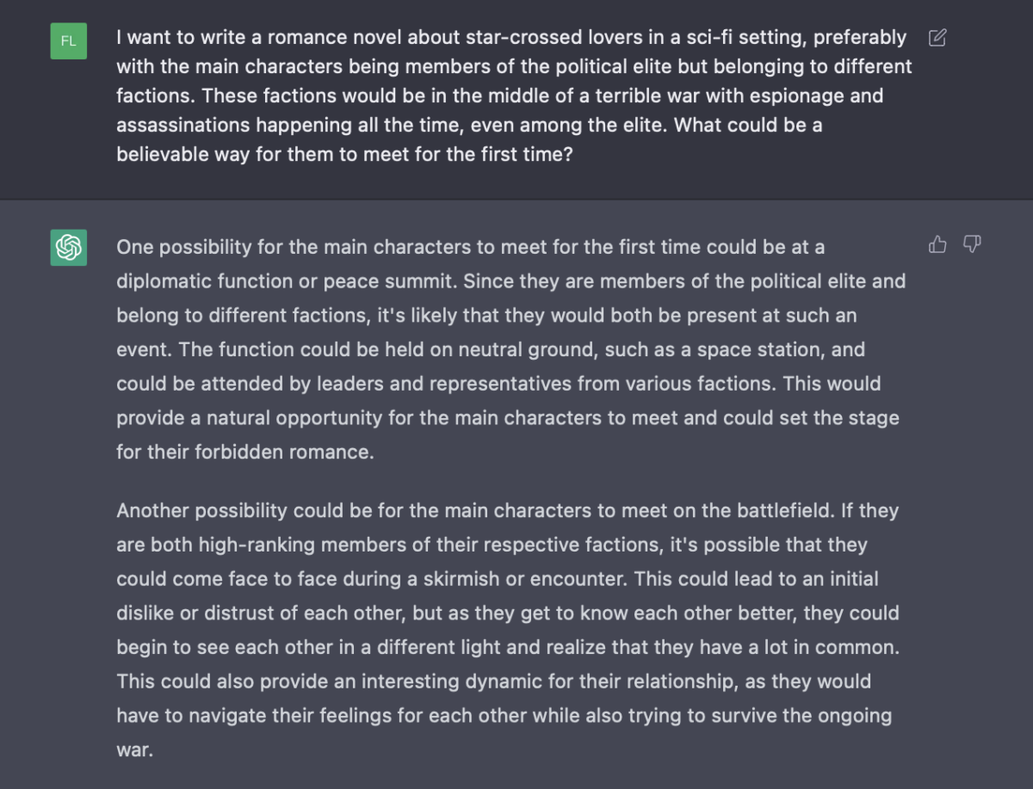
ChatGPT & friends
https://www.linkedin.com/pulse/rise-llm-chatbots-bhasker-gupta/

Slide 9
Common NLP tasks
Word tokenization
Sentence boundary detection
Part-of-speech (POS) tagging
Named Entity (NE) recognition
Parsing
Semantic analysis
9

Slide 10
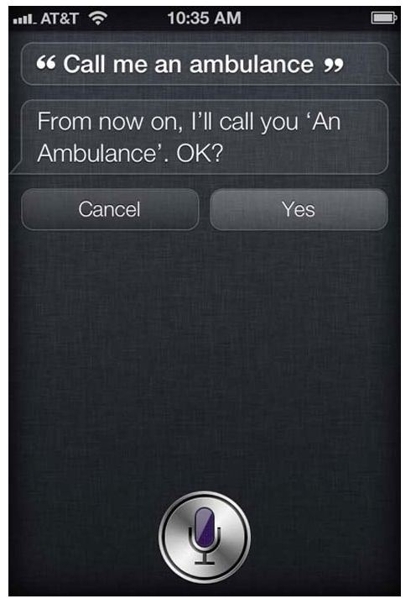
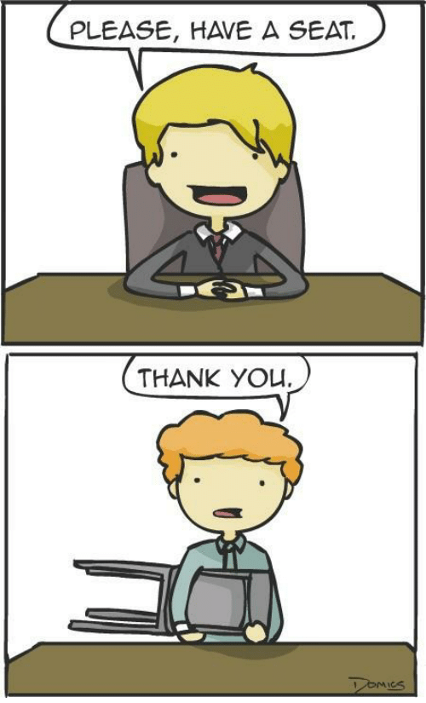
NLP challenges: Ambiguity

Slide 11
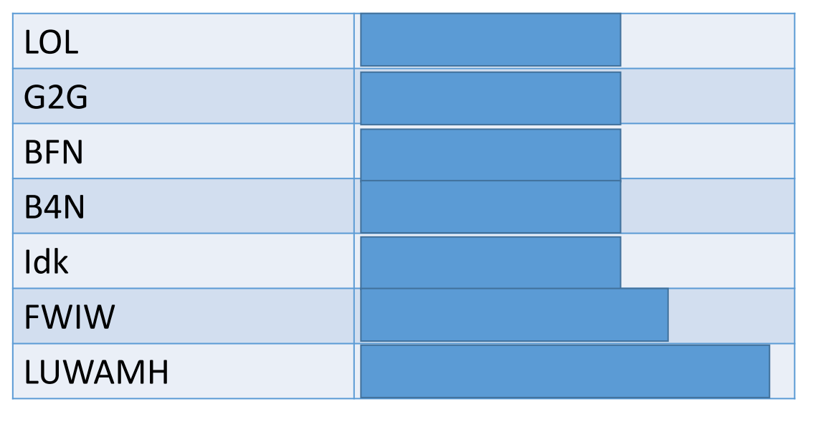
NLP challenges: Dynamism
Language evolves (i.e cyber lingua)

Slide 12
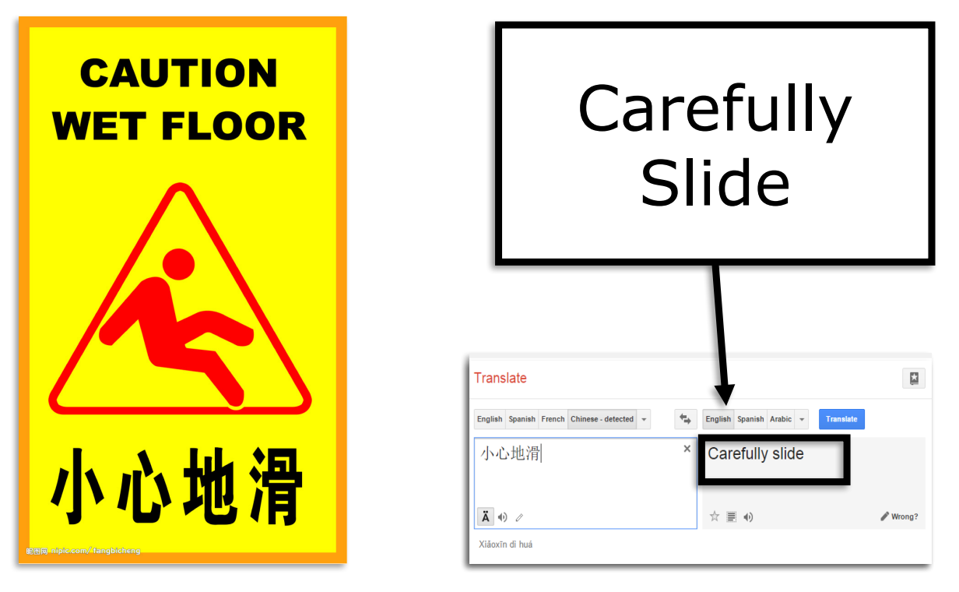
NLP challenges: Composition

Slide 13
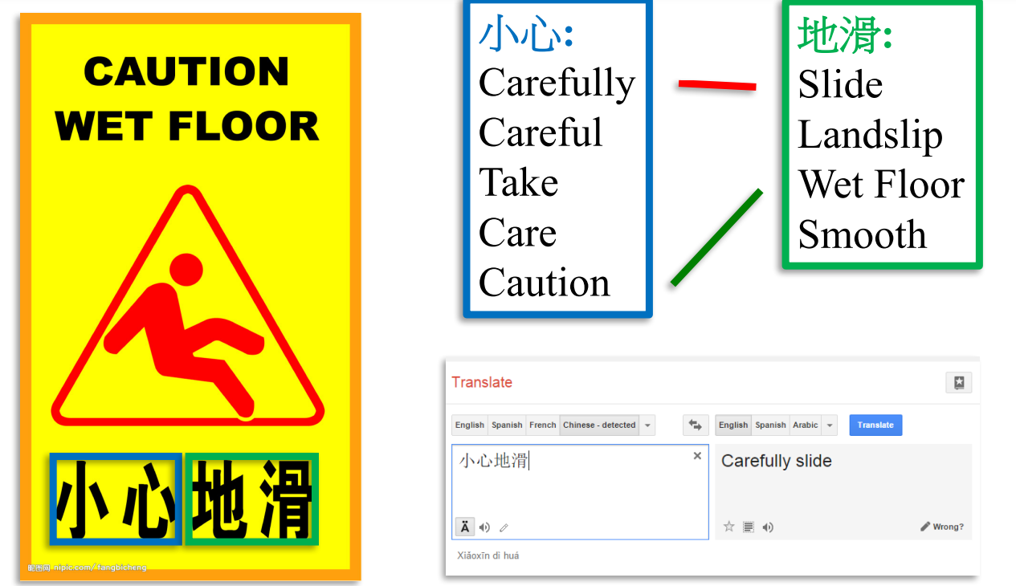
NLP challenges: Composition

Slide 14
NLP challenges: Scale
Penn Tree bank ~1M from Wall street journal
Newswire collection: 500M+
Wikipedia: 2.9 billion word (English)
Web: several billions of words

Slide 15
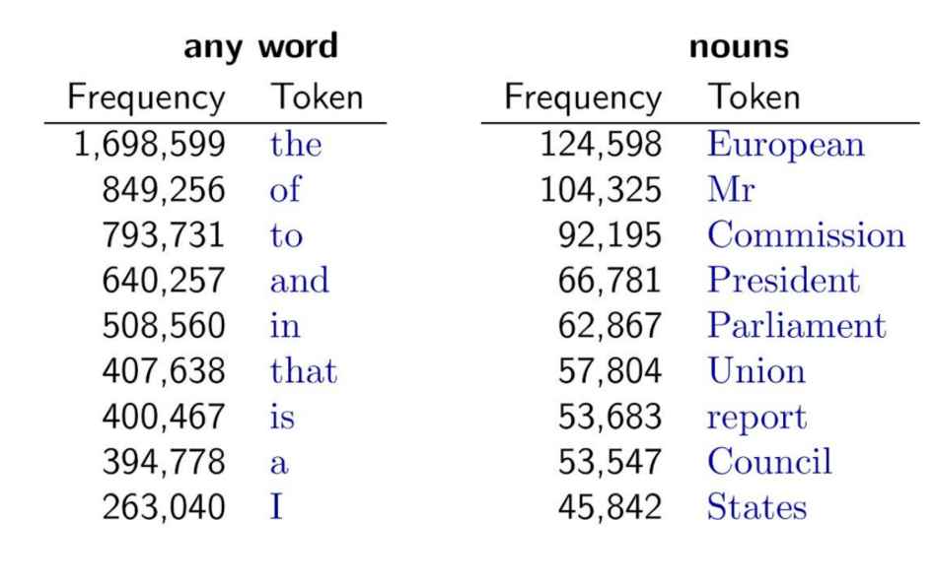
NLP challenges: Sparsity

Slide 16
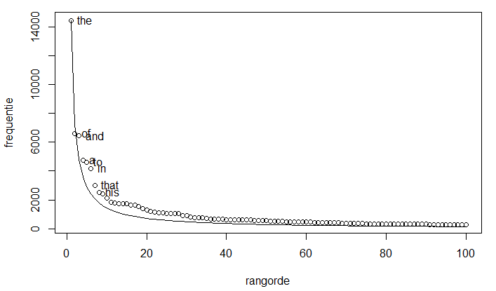
NLP challenges: Sparsity
Zipf’s Law: The frequency of any word is inversely proportional to its rank in the frequency table.

Slide 17
Desiderate for NLP Models
Sensitivity to a wide range of phenomena and constraints in human language
Generality across languages, modalities, genres, styles
Strong formal guarantees (e.g., convergence, statistical efficiency, consistency)
High accuracy when judged against expert annotations or test data
Ethical
17

Slide 18
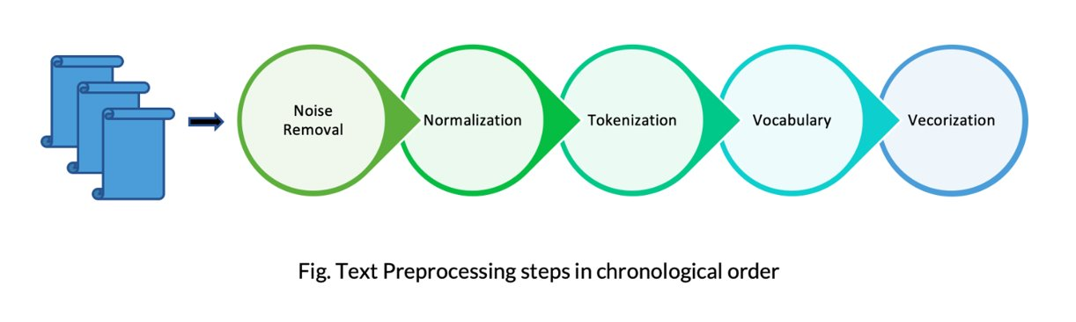
Before feature extraction…

Slide 19
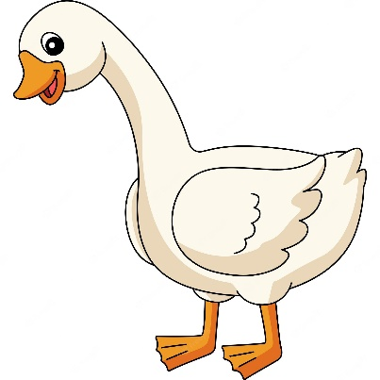
Before feature extraction…
Lowercase

Slide 20
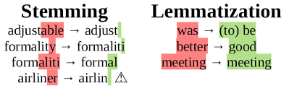
Before feature extraction…
Lowercase
Normalization:
- Stemming: removing inflectional affixes whales to whale
- Lemmatization: converting to a base form geese to goose

Slide 21
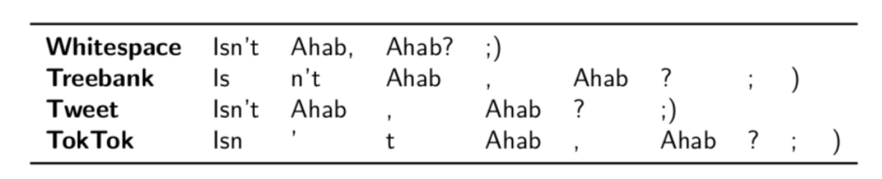
Before feature extraction…
Lowercase
Normalization:
- Stemming: removing inflectional affixes whales to whale
- Lemmatization: converting to a base form geese to goose
Tokenization:
Some languages are written in scripts that do not include whitespace (Chinese, Thai, Vietnamese)

Slide 22
Before feature extraction…
Lowercase
Normalization:
- Stemming: removing inflectional affixes whales to whale
- Lemmatization: converting to a base form geese to goose
Tokenization:
Some languages are written in scripts that do not include whitespace (Chinese, Thai, Vietnamese)
Remove Stopwords and Punctuations (“the”, “is” and “and”)

Slide 23
Before feature extraction…
Lowercase
Normalization:
- Stemming: removing inflectional affixes whales to whale
- Lemmatization: converting to a base form geese to goose
Tokenization:
Some languages are written in scripts that do not include whitespace (Chinese, Thai, Vietnamese)
Remove Stopwords and Punctuations (“the”, “is” and “and”)
Vocabulary size limitation

Slide 24
Before feature extraction…
How to convert words to numerical representations?

Slide 25
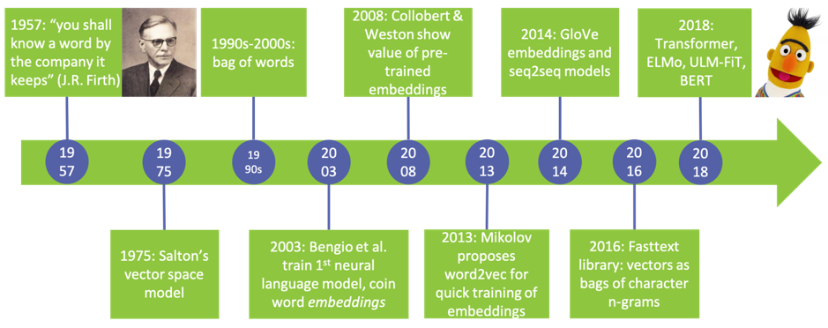
NLP timeline

Slide 26
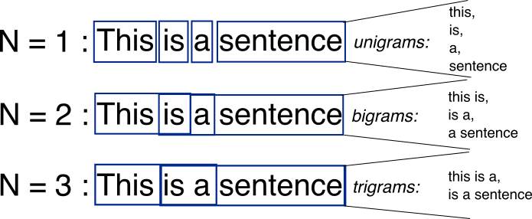
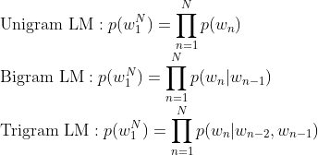
N-grams

Slide 27
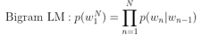
N-grams
Corpus
He said thank you.
He said bye as he walked through the door.
He went to San Diego.
San Diego has nice weather.
It is raining in San Francisco
Thank ….

Slide 28
N-grams
Corpus
He said thank you.
He said bye as he walked through the door.
He went to San Diego.
San Diego has nice weather.
It is raining in San Francisco
Nr. “Thank you” occurs
P (you | thank) =
Nr. “Thank” occurs
Thank ….

Slide 29
N-grams
Corpus
He said thank you.
He said bye as he walked through the door.
He went to San Diego.
San Diego has nice weather.
It is raining in San Francisco
Nr. “Thank you” occurs
P (you | thank) =
= 1
Nr. “Thank” occurs
Thank ….

Slide 30
N-grams
Corpus
He said thank you.
He said bye as he walked through the door.
He went to San Diego.
San Diego has nice weather.
It is raining in San Francisco
Nr. “Thank you” occurs
P (you | thank) =
= 1
Nr. “Thank” occurs
Thank ….
Thank you

Slide 31
N-grams
Corpus
He said thank you.
He said bye as he walked through the door.
He went to San Diego.
San Diego has nice weather.
It is raining in San Francisco
Nr. “Thank you” occurs
P (you | thank) =
= 1
Nr. “Thank” occurs
Thank ….
Thank you
Some issues: Sparsity and unseen words
Larger n-grams are more accurate but more expensive as well

Slide 32
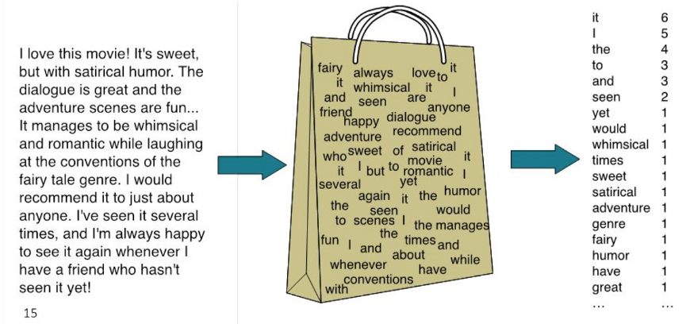
BAG OF WORDS

Slide 33
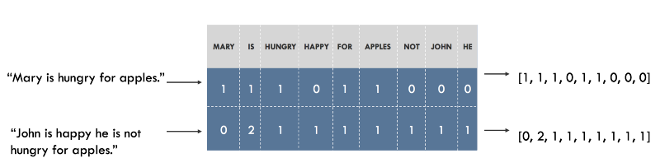
BAG OF WORDS
The simplest way to vectorize texts into numeric representations with a fixed size.

Slide 34
BAG OF WORDS
The simplest way to vectorize texts into numeric representations with a fixed size.
Some issues: Does not care about the order of words
Large vocabularies
Raw absolute frequency counts of words do not necessarily represent the meaning of the text properly.

Slide 35
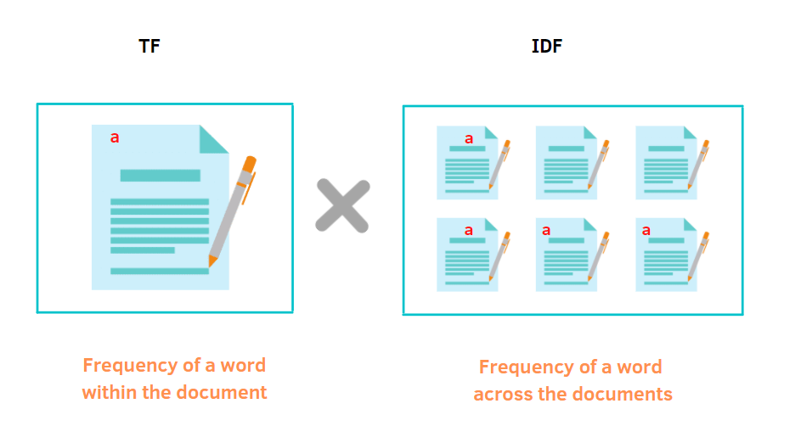
TF-IDF
Rare words in one document that are not appearing in others might be very important

Slide 36
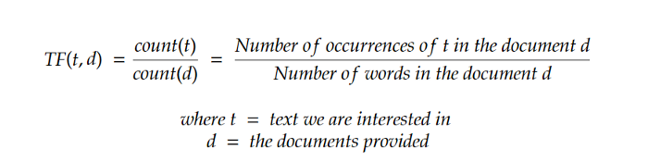
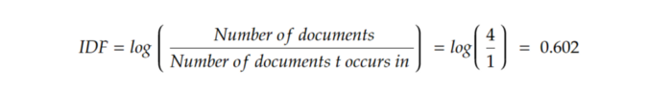
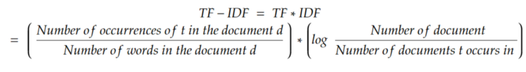
TF-IDF

Slide 37
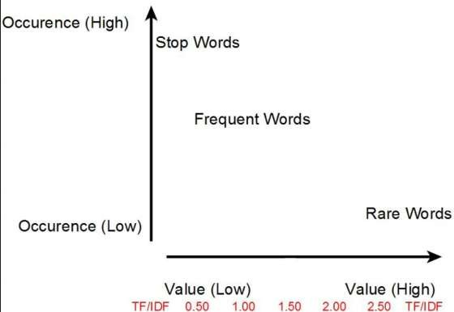
TF-IDF
Rare words in one document that are not appearing in others might be very important

Slide 38

Prediction based Vectorization
Embeddings

Slide 39
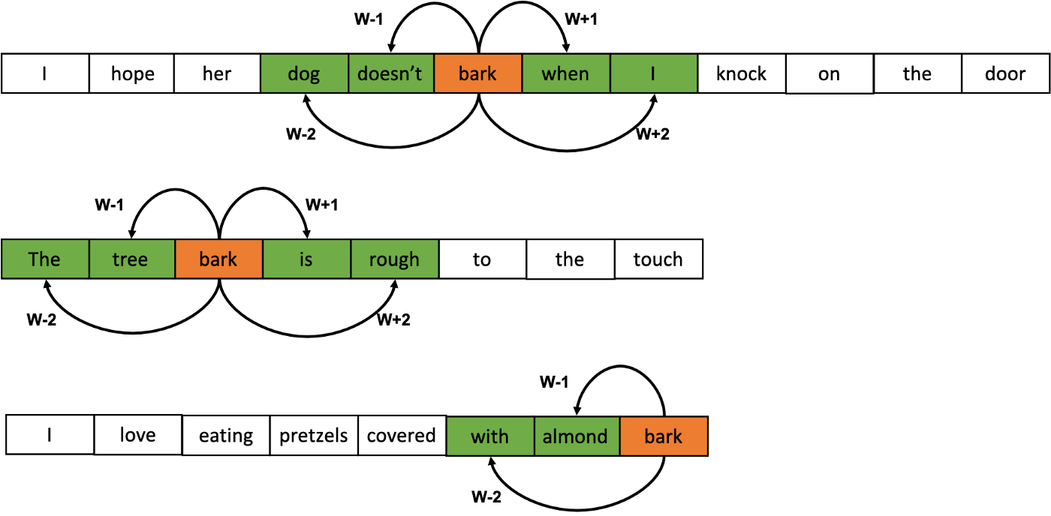
Word2Vec
Consider word context

Slide 40
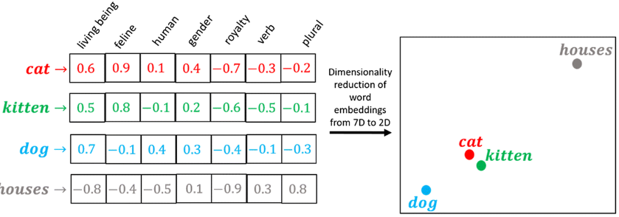
Word2Vec
Place similar words closer

Slide 41
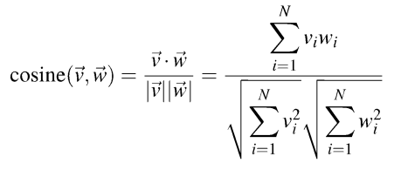
Word2Vec
Place similar words closer
Similarity calculation

Slide 42
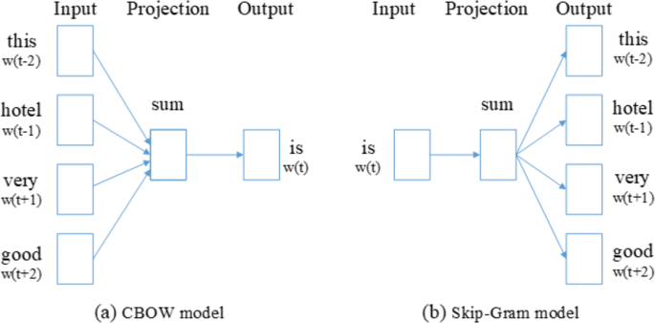
Word2Vec
This hotel is very good
CBOW

Slide 43
Word2Vec
This hotel is very good
CBOW
Vocab dim.
Embed.
Dim.
Window size
x
vocab dim.

Slide 44
Word2Vec
This hotel is very good
CBOW
Skip-gram
Vocab dim.
Embed.
Dim.
Window size
x
vocab dim.

Slide 45
FastText – Extension of Word2Vec
Considers internal structure of the words for a skip gram model
Each word is represented as a bag of character n-gram.
Tri-gram of “where”
<wh, whe, her, ere, re> and <where>

Slide 46
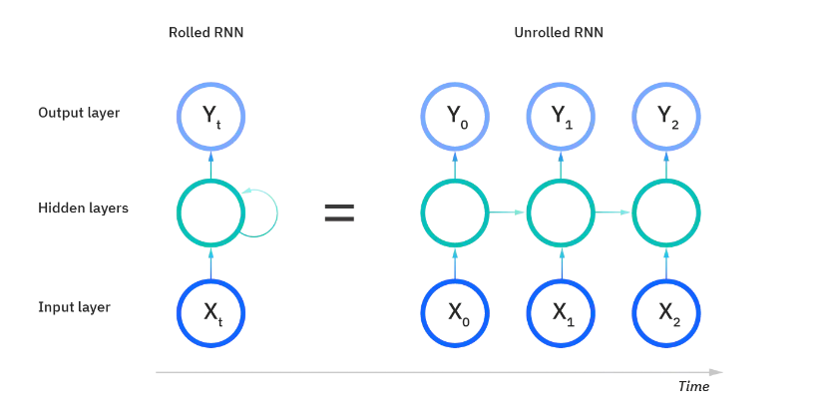
Recurrent neural networks

Slide 47

Recurrent neural networks
https://towardsdatascience.com/illustrated-guide-to-recurrent-neural-networks-79e5eb8049c9

Slide 48
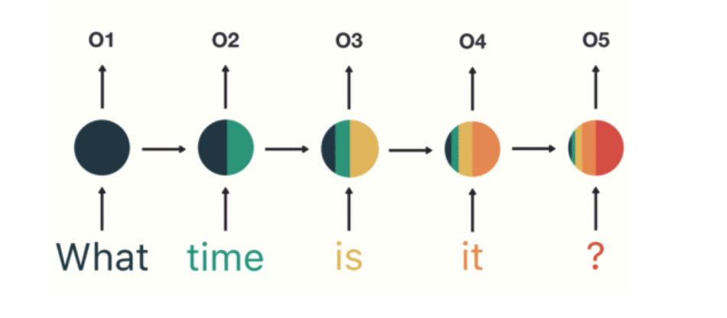
Recurrent neural networks
https://towardsdatascience.com/illustrated-guide-to-recurrent-neural-networks-79e5eb8049c9

Slide 49
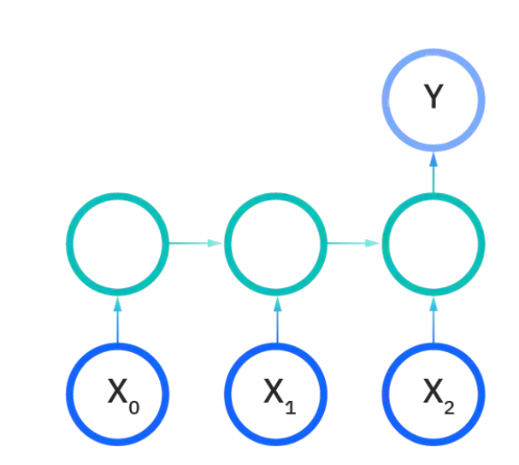
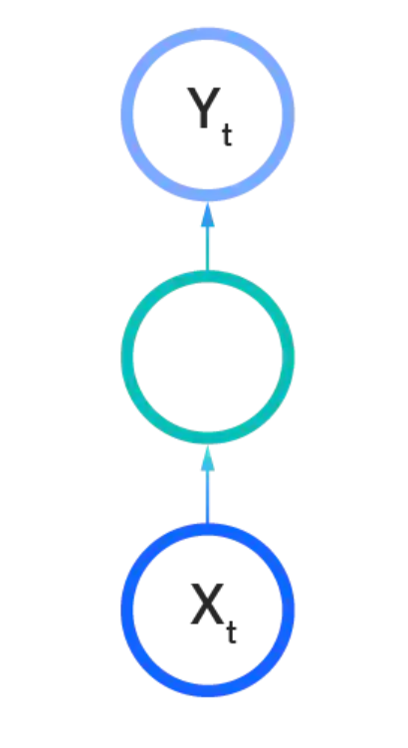
Recurrent neural networks
Traditional neural network
Classification task (i.e sentiment analysis)
One-to-one
Many-to-one

Slide 50
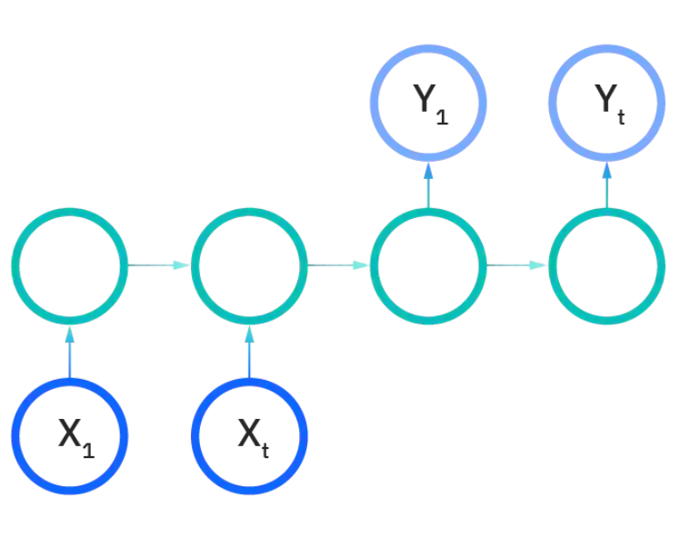
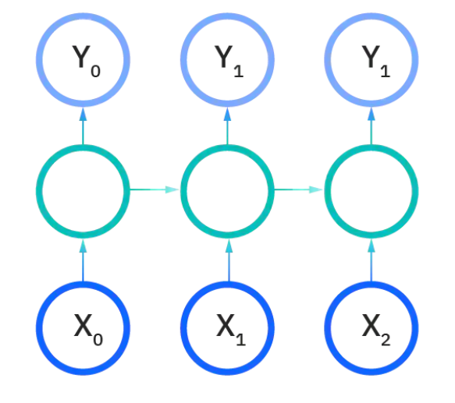
Recurrent neural networks
Translation
Name entity recognition
Many-to-many
Many-to-many

Slide 51
Recurrent neural networks
RNN Advantages:
Can process any length input
Computation for step t can (in
theory) use information from many steps back
Model size doesn’t increase for longer input context
Same weights applied on every
timestep, so there is symmetry in how inputs are processed.
RNN Disadvantages:
Recurrent computation is slow
In practice, difficult to access information from many steps back

Slide 52
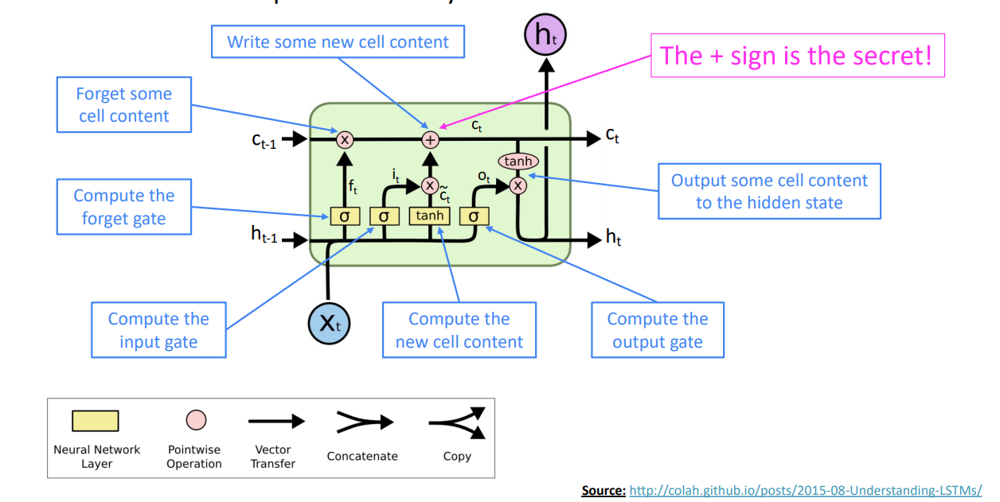
LSTM

Slide 53
LSTM
The LSTM architecture makes it easier to preserve information over many timesteps
• e.g., if the forget gate is set to 1 for a cell dimension and the input gate set to 0, then the information of that cell is preserved indefinitely.
LSTM doesn’t guarantee that there is no vanishing/exploding gradient

Slide 54
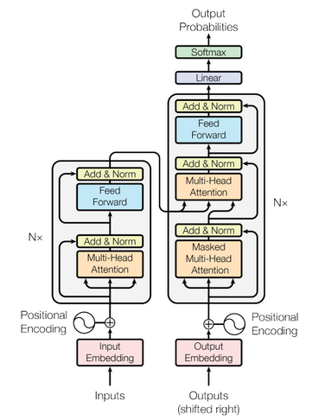
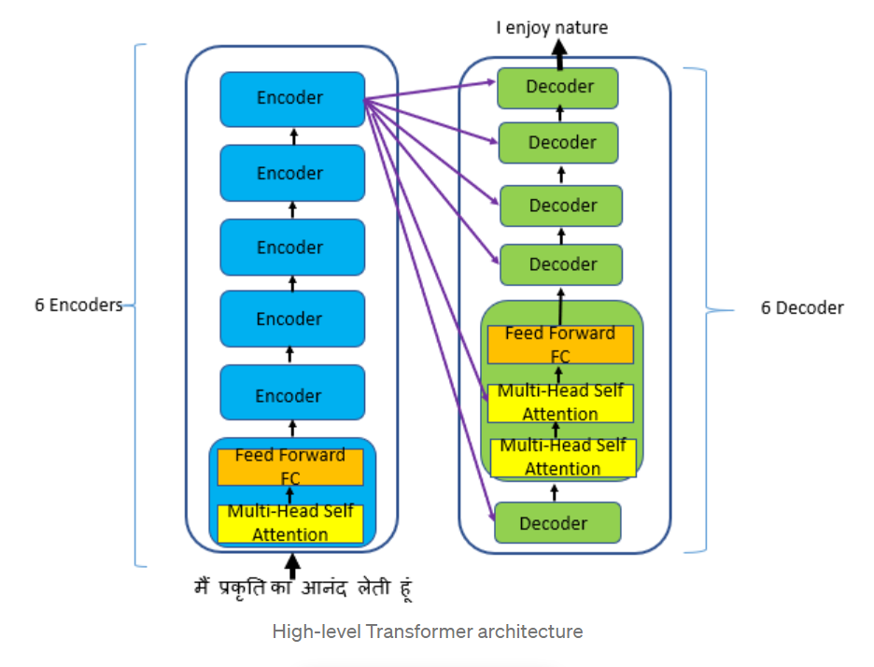
Transformers

Slide 55

Pretrained models for language embeddings

Slide 56
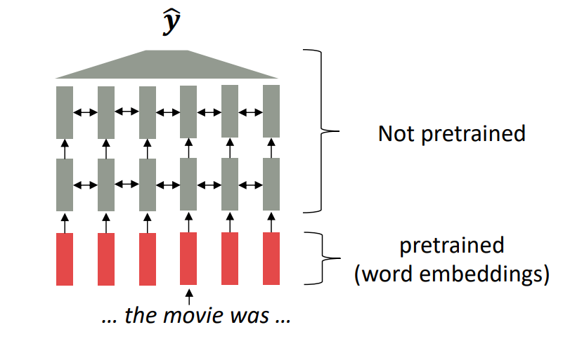
Pretrain/Finetune paradigm
Up to 2017-2018:
• Start with pretrained word embeddings (no context!)
• Learn how to incorporate context in an LSTM while training on the task.
Issue:
• The training data we have for our downstream task (like question answering) must be sufficient to teach all contextual aspects of language.

Slide 57
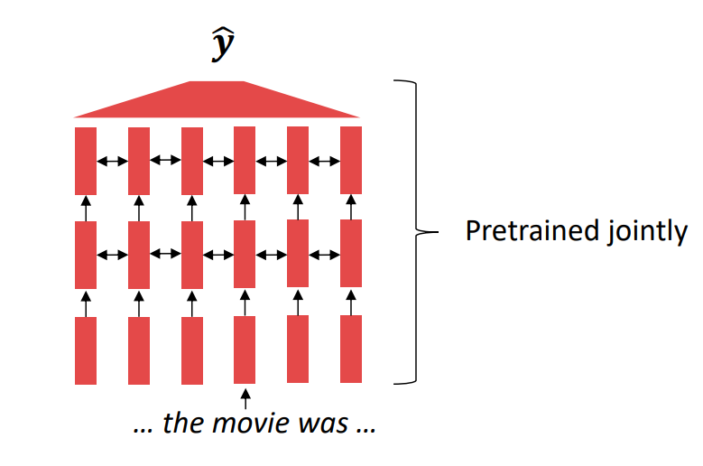
Pretrain/Finetune paradigm
Now:
All (or almost all) parameters in NLP networks are initialized via pretraining.
Pretraining methods hide parts of the input from the model, and then train the model to reconstruct those parts.

Slide 58
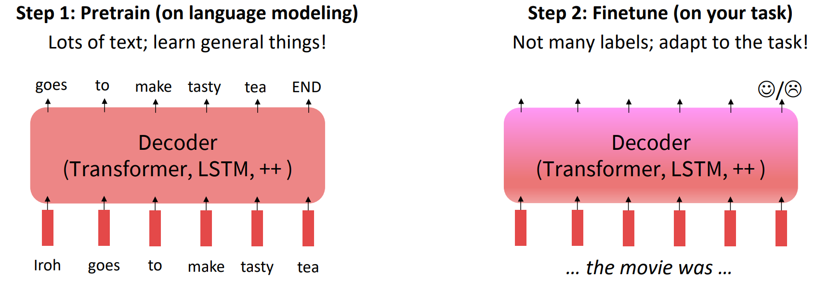
Pretrain/Finetune paradigm

Slide 59
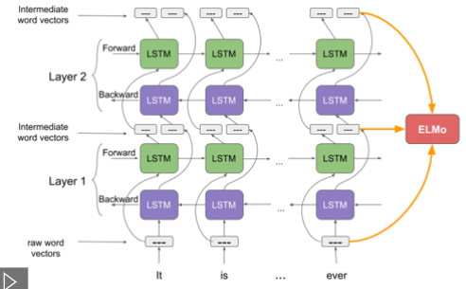
ELMo: Deep contextualized word representations
Train an LSTM-based language model
Use the hidden states of the LSTM for each token to generate a vector representation of each word

Slide 60
ELMo: Deep contextualized word representations
(ELMo) is the weighted sum of the raw word vectors and the 2 intermediate word vectors
It produces dynamic embeddings
Lower layers embedding - syntax
Higher layers – context dependent
It's your turn to wash the dishes = plates.
How long does it take to cook this dish? = a meal.
Polysemy

Slide 61


BERT embeddings

Slide 62

BERT embeddings

Slide 63
BERT embeddings
Sum all 12 hidden layers
Sum only some of the last hidden layers
Concatenate some of the last layers

Slide 64
Part 2

Slide 65

A short break with a riddle
A man and his son are in a terrible accident and are rushed to the hospital in critical care.
The doctor looks at the boy and exclaims "I can't operate on this boy, he's my son!“
How could this be?

Slide 66


Slide 67



Slide 68
Media are ﬁltered, ranked, aggregated..
Training data are collected and annotated
People see output
Model is trained

Slide 69
Training data are collected and annotated
Human Biases in Data
Reporting bias | Stereotypical bias | Group attribution error
Selection bias | Historical unfairness | Halo eﬀect
Overgeneralization | Implicit associations
Out-group homogeneity bias | Implicit stereotypes
 | Prejudice
Human Biases in Collection and Annotation
Sampling error | Bias blind spot | Neglect of probability
Non-sampling error | Conﬁrmation bias | Anecdotal fallacy
Insensitivity to sample size | Subjective validation | Illusion of validity
Correspondence bias | Experimenter’s bias
In-group bias | Choice-supportive bias

Slide 70
Human reporting bias
Word corpus Frequency in
“spoke” | 11,577,917
“laughed” | 3,904,519
“murdered” | 2,834,529
“inhaled” | 984,613
“breathed” | 725,034
“hugged” | 610,040
“blinked” | 390,692
“exhale” | 168,985
The frequency with which people write about actions, outcomes, or properties is not a reflection of real-world frequencies or the degree to which a property is characteristic of a class of individuals

Slide 71

Human reporting bias

Slide 72

Selection Bias: Selection does not reﬂect a random sample
World Englishes
Is the data we use to train our English NLP models representative of all the Englishes out there?

Slide 73









Out-group homogeneity bias: Tendency to see outgroup members as more alike than ingroup members

Slide 74

Labels

Slide 75

Labels

Slide 76

Biased Labels: Annotations in your dataset will reﬂect the worldviews of your annotators.

Slide 77

Map of Amazon Mechanical Turk Workers

Slide 78
Bias Laundering
Human data perpetuates human biases.
As ML learns from human data, the result is a bias network eﬀect

Slide 79
Predicting Toxicity in Text
Toxicity is defined as... "a rude, disrespectful, or unreasonable comment that is likely to make you leave a discussion."
Comment | Toxicity Score
The Gay and Lesbian Film Festival starts today. | 0.82
Being transgender is independent of sexual orientation. | 0.52
A Muslim is someone who follows or practices Islam | 0.46

Slide 80
Predicting Toxicity in Text
Toxicity is defined as... "a rude, disrespectful, or unreasonable comment that is likely to make you leave a discussion."

Slide 81
Predicting Toxicity in Text
Comment | Toxicity Score
I am a person. | 0.08
I am a tall person. | 0.03
I am a blind person. | 0.39
I am a deaf person. | 0.44
I am a person with mental illness. | 0.62

Slide 82

But aren’t they just reflecting Society?

Slide 83
Shouldn’t we then just leave them as is?
Would that harm certain groups of people?
Associative Harm
“when systems reinforce the subordination of some groups along the lines of identity”
Allocative Harm
“when a system allocates or withholds a certain opportunity or resource”

Slide 84

Language models are not safe from attacks
Poisoning attacks

Slide 85


Adversarial attacks against Machine Learning (ML)
Cute Dog
97%
Carefully crafted
adversarial noise
Angry Cat
82%
Notes:
Adversarial attacks create carefully altered inputs, named adversarial examples, aiming to fool Machine Learning systems. Adversarial examples are extensively studied in computer vision, with a variety of existing attacks.

Slide 86


Adversarial attacks against text-based models
An imaginative comedy/thriller
Positive

Slide 87

Adversarial attacks against text-based models
An imaginative comedy/thriller
Positive
Character-level
Ann imagunatove comedy/Thrillir
Negative

Slide 88
Adversarial attacks against text-based models
An imaginative comedy/thriller
Positive
Word-level
A creative comedy/thriller
Negative

Slide 89
Adversarial attacks against text-based models
An imaginative comedy/thriller
Positive
Paraphrase
A brilliantly crafted and captivating imaginative comedy/thriller experience.
Negative

Slide 90




Human in the loop
Phishing
Fake news
Offensive language

Slide 91


Desired properties of adversarial text
Valid & Natural
I love this movie I like this movie
Invalid
Unnatural
I love this movie I hate this movie
I love this movie i LoVe tHiss cinEmatiC

Slide 92


Bert-attack
https://arxiv.org/pdf/2004.09984
Select top-k words to perturb
Apply attack

Slide 93

Characteristics of textual adversarial attacks

Slide 94

Characteristics of textual adversarial attacks

Slide 95
Protecting against adversarials
Adversarial
examples

Slide 96
Protecting against adversarials
Adversarial
examples

Slide 97

Problem does not get solved with LLMs

Slide 98


Adversarial examples for sound
“the boy looked out at the horizon”
“later we simply let life proceed in its own direction toward its own fate”
Carlini, Nicholas, and David Wagner. "Audio adversarial examples: Targeted attacks on speech-to-text.“ 2018 IEEE Security and Privacy Workshops (SPW). IEEE, 2018.
Notes:
Up to 50 characters per second of audio

Slide 99
This lecture reuses content from the non-exhaustive list of courses below:
https://www.cs.columbia.edu/~amueller/comsw4995s20/schedule/
https://web.stanford.edu/class/cs224n/
https://www.phontron.com/class/anlp2022/

